Slide 1

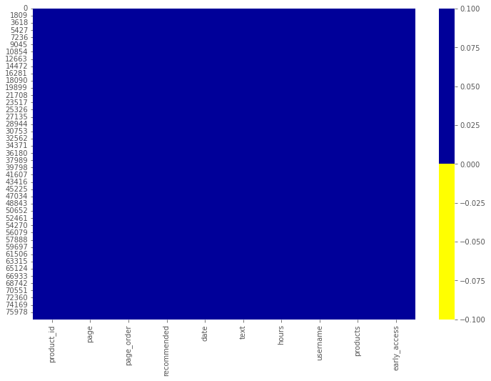
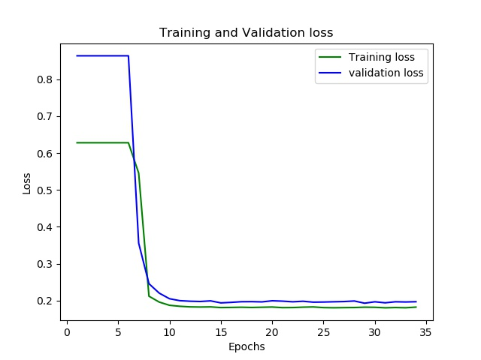
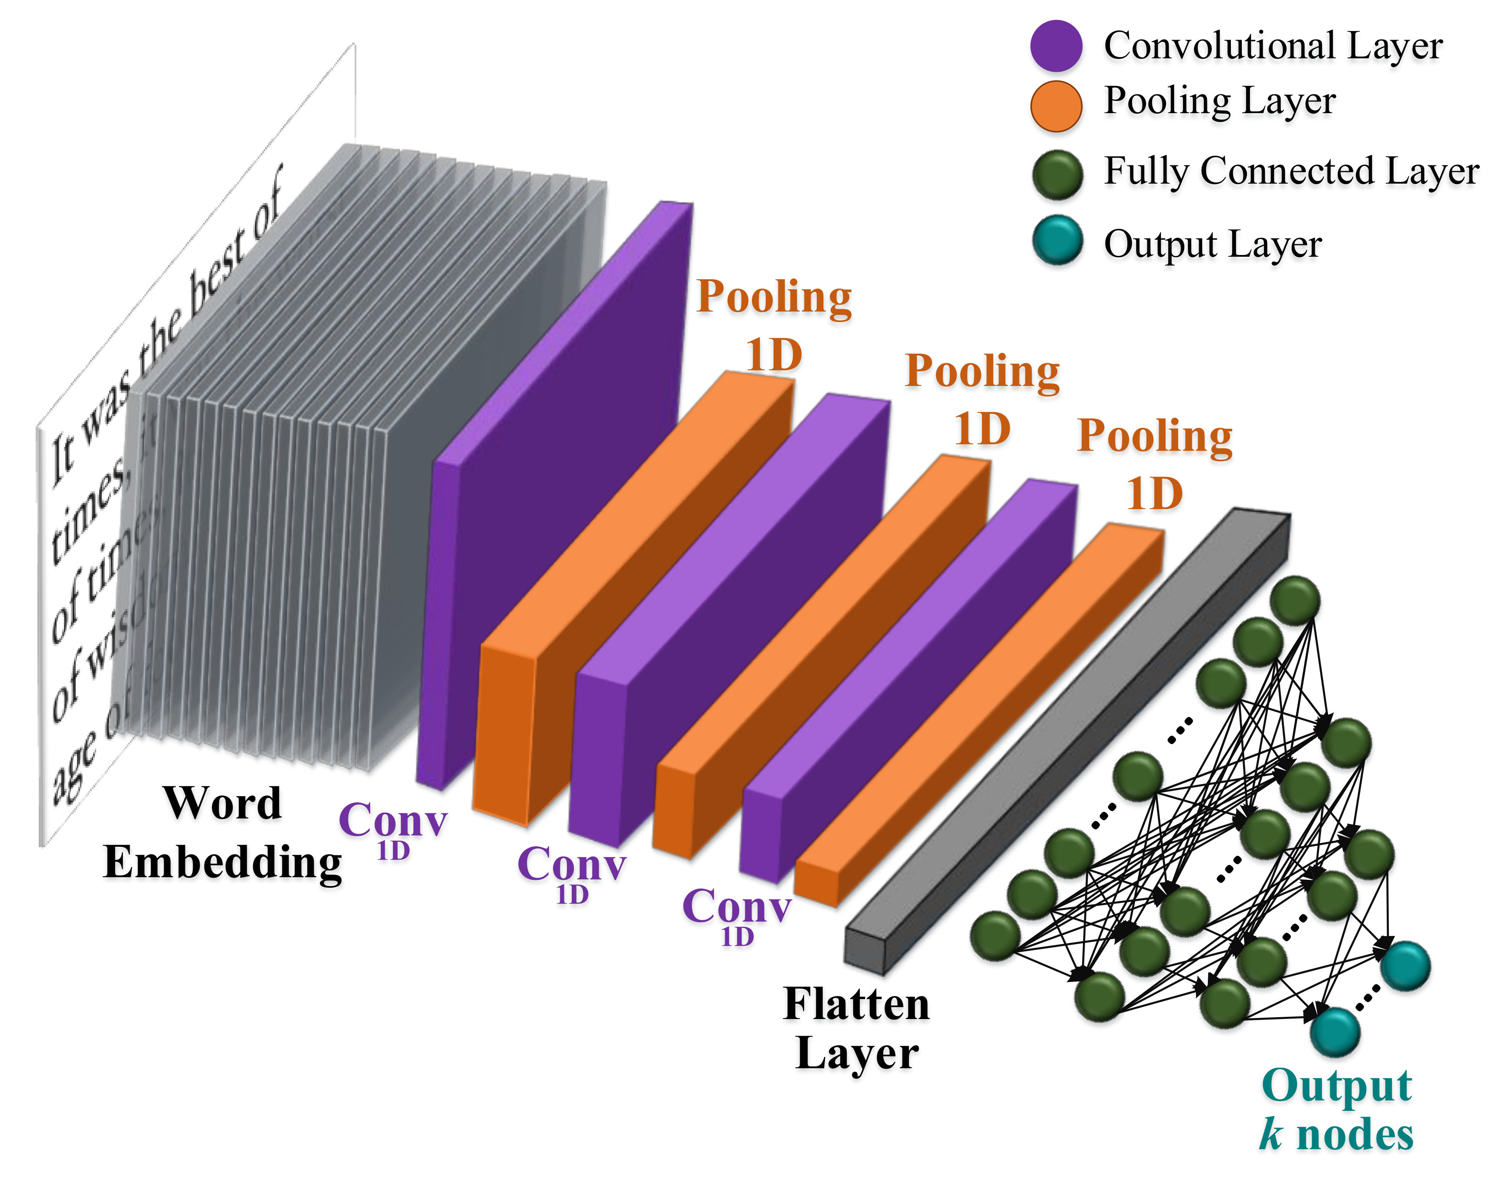
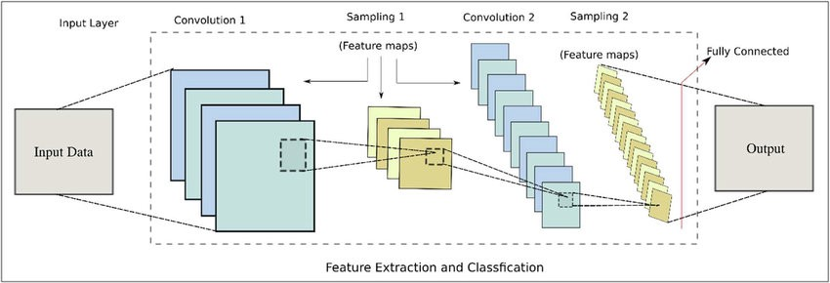
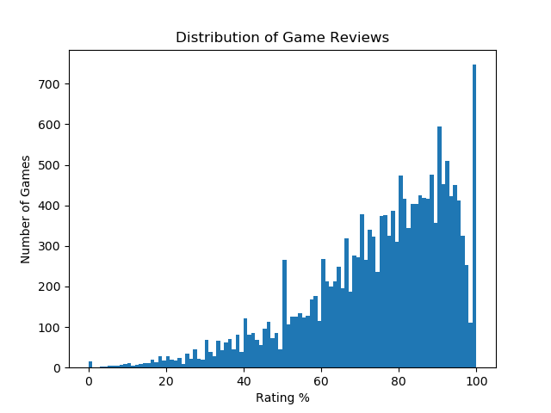
Automated Bugs Identification Through Early Access Game Review Analytics on Game Distribution Platforms
Background
Method
Results
The game industry has become one of the most profitable markets in the entertainment industry.
Knowing what users think and how they feel about a game is a central piece to drive the decision making process.
Studying gamer reviews help developers better understand the concerns and further improve the user perceived quality.
Using Game STEAM platform as a case study to collect reviews of games using custom scraper.
Pre-processing (Cleaning, NLP techniques, labeling) of the reviews.
Deep learning model (Convolutional neural network) multi-label review classifier is used for classification of reviews into defined set of labels.
Testing data for the evaluation of the model.
Reviews Scraping
Pre-Processing
Model Training
Results are concluded for the after the synthetically labelling of the first 500 reviews of different game.
With the partition of data 70% training data and 30% test data.
CNN was able to predict the bugs from reviews with 72% accuracy.
Figure 1.2 Methodology Steps
Research Questions
RQ1: What kind of techniques has been proposed in past for classification and identification of bugs from gaming reviews?
RQ2: What classification and evaluation metrics are used?
Figure 1.3 Data representation after Pre-processing
Figure 1.5 CNN Model training and validation loss
Experimental Data
Early access games review's from Game distribution platform STEAM.
Author:
ALI SHAHBAZ | i202020@nu.edu.pk
Supervisor:
DR. KHUBAIB AMJAD ALAM | khubaib.amjad@nu.edu.pk
Figure 1.1 Convolutional Neural Network
Figure 1.4 CNN Model

